Slide 1

AWS Lambda
Serverless Compute Service

Slide 2
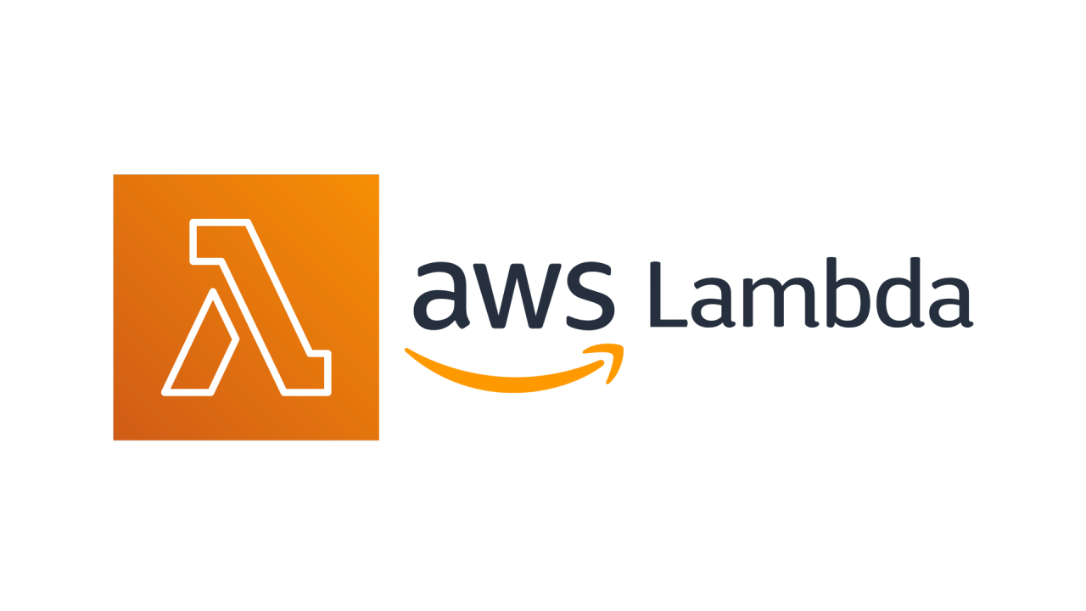
Introduction
AWS Lambda is a serverless computing service that runs code in response to events and automatically manages the underlying infrastructure. It enables scalable and cost-efficient execution of functions without the need to provision or manage servers.

Slide 3

01
AWS Lambda Overview

Slide 4

What is AWS Lambda
AWS Lambda is a fully managed service that executes code triggered by events. It eliminates server management and scales automatically, supporting multiple programming languages.

Slide 5
Key Features and Benefits
Key features include automatic scaling, pay-per-use pricing, and built-in fault tolerance. Benefits are improved agility, reduced costs, and simplified infrastructure management.

Slide 6
Use Cases and Applications
AWS Lambda supports web applications, data processing, real-time file processing, and backend services for mobile apps. It is widely used for automation and integrating with other AWS services.

Slide 7

02
AWS Lambda Architecture

Slide 8
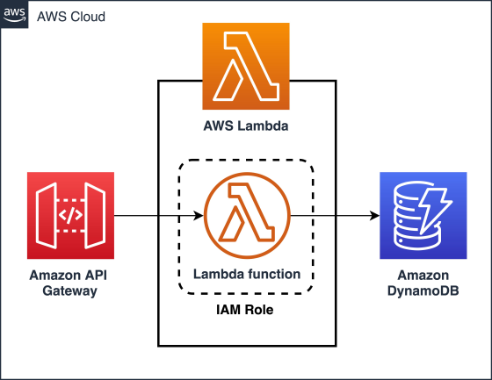
Event Sources and Triggers
Lambda functions are invoked by events from services like Amazon S3, DynamoDB, API Gateway, and CloudWatch. These triggers enable asynchronous and real-time processing.

Slide 9
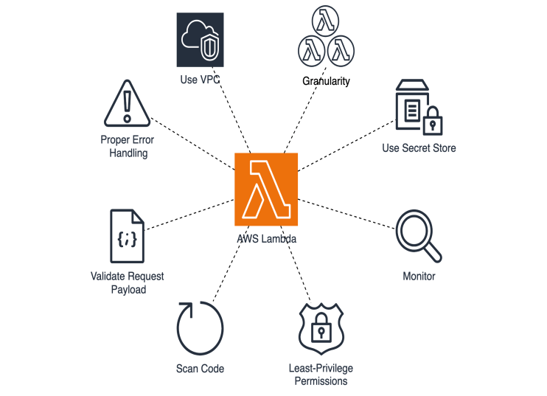
Function Deployment and Management
Functions can be deployed via the AWS Management Console, CLI, or Infrastructure as Code tools. Code packages and environment configurations are managed seamlessly.

Slide 10

Monitoring, Security, and Best Practices
Monitoring is done through CloudWatch Logs and metrics. Security best practices include applying minimal IAM roles, using environment variables securely, and enabling VPC integration when necessary.

Slide 11

Conclusions
AWS Lambda offers scalable, cost-effective serverless compute with broad event integration and strong security features. It simplifies application deployment and improves operational efficiency.

